Slide 1


IT 307 ML UNIT 1 Introduction to ML
Presented by Dr. Ankush Sawarkar
Email: adsawarkar@sggs.ac.in

Slide 2
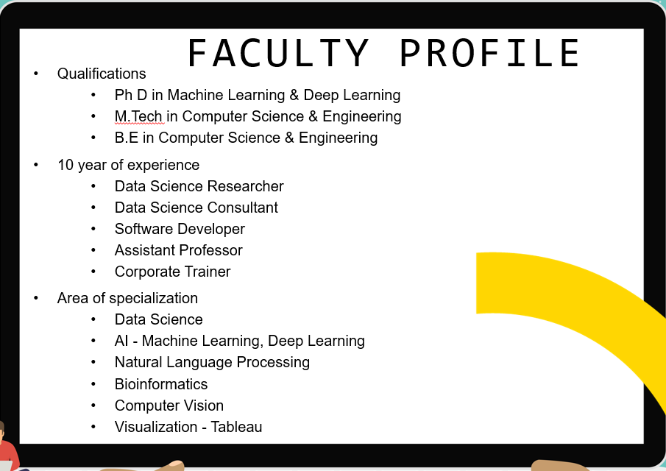
Research Publication
15 Research papers
660+ citations
https://scholar.google.com/citations?hl=en&user=Y3CY1-wAAAAJ
Dr. Ankush D. Sawarkar (Ph.D. VNIT Nagpur)
Assistant Professor, Dept. Information Technology,
Email| adsawarkar@sggs.ac.in / ankush1sawarkar@gmail.com
https://orcid.org/my-orcid?orcid=0000-0001-7099-1987 https://www.webofscience.com/wos/author/record/ABE-6640-2020 https://www.scopus.com/authid/detail.uri?authorId=56669766500 https://www.researchgate.net/profile/Ankush-Sawarkar https://sites.google.com/view/ankushsawarkar/home

Slide 3
Books:
Kevin Murphy, Machine Learning: A Probabilistic Perspective, MIT Press, 2012.
Machine Learning For Dummies by John Mueller and Luca Massaron
Trevor Hastie, Robert Tibshirani, Jerome Friedman, The Elements of Statistical Learning, Springer 2009 (freely available online).
Christopher Bishop, Pattern Recognition and Machine Learning, Springer, 2007

Slide 4
At the end
of this course
Machine Learning, Types of ML
Regression/ Classification / Clustering
Overfitting & Underfitting
Model Selection - MAE/ RMSE/ Regularization
Evaluation Metrics - Confusion Matrix (TP/TN/FP/FN)/ Accuracy/ Precision/ Recall/ F1Score
Logistics Regression/ Sigmoid/ Limitation of Logistics Reg
Decision Tree - Gini Index/ Information Gain
K Fold Cross Validation/ K- Nearest Neighbors/ Random Forest
Support Vector Machine (SVM) Tuning Parameter
Clustering - Kmeans/ Elbow method/ Performance measures

Slide 5
ML Techniques Overview
“The field of study that gives computers the ability to learn without being explicitly programmed.” - Arthur Samuel
“A computer program is said to learn from experience E with respect to some class of tasks T and performance measure P if its performance at tasks in T, as measured by P, improves with experience E”. - Tom Mitchell

Slide 6

6
AI Landscape

Slide 7
AI Landscape…
AI
Machine Learning
Expert Systems
Deep Learning
Rule based systems to solve specific problems
ML driven by Neural Networks
Stats + Algorithms
What are the factors driving the development of AI ?

Slide 8
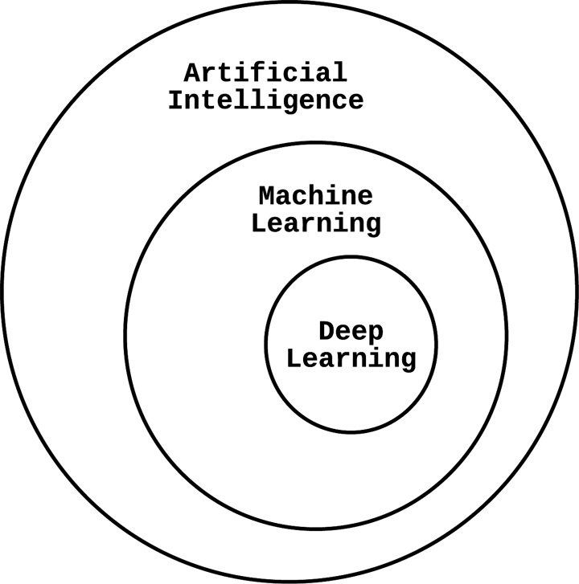
Another way of looking

Slide 9
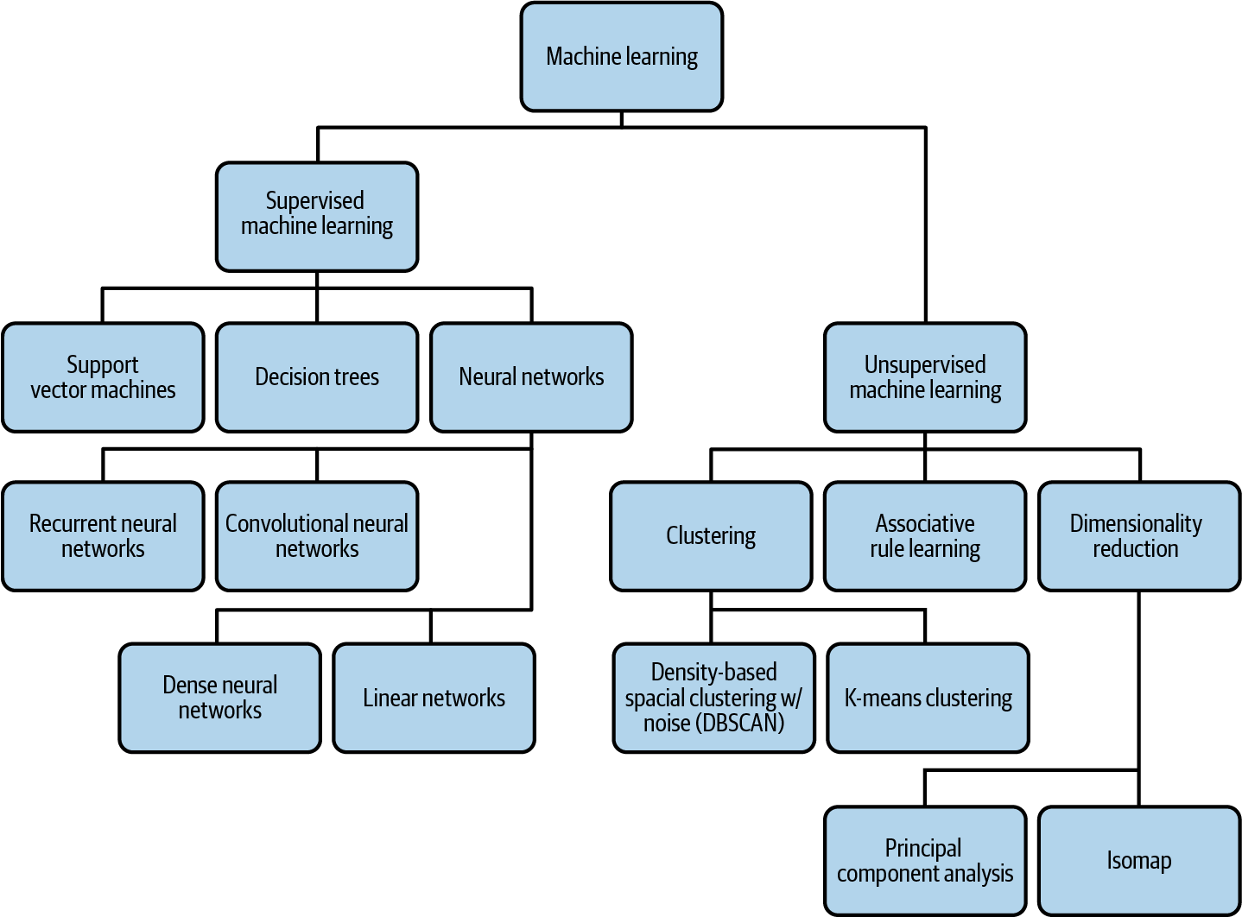

Slide 10
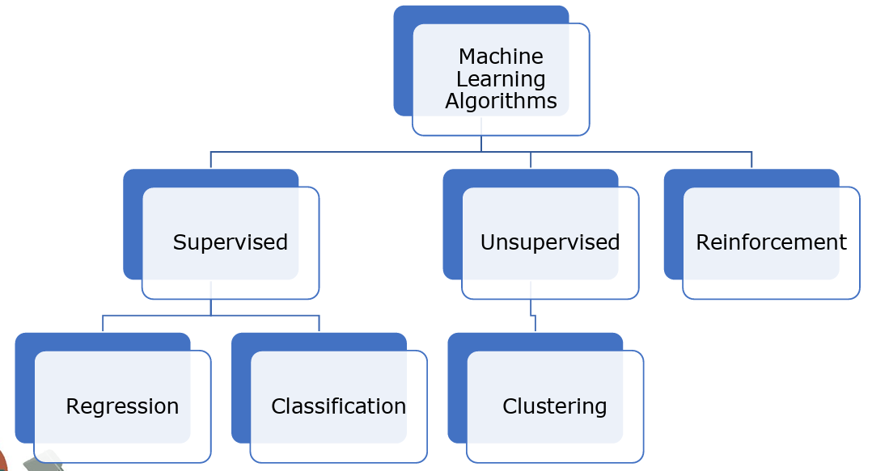
Machine Learning

Slide 11
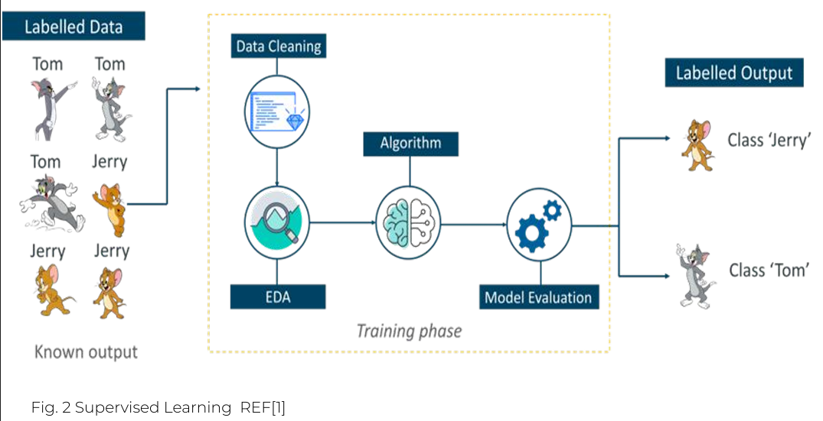
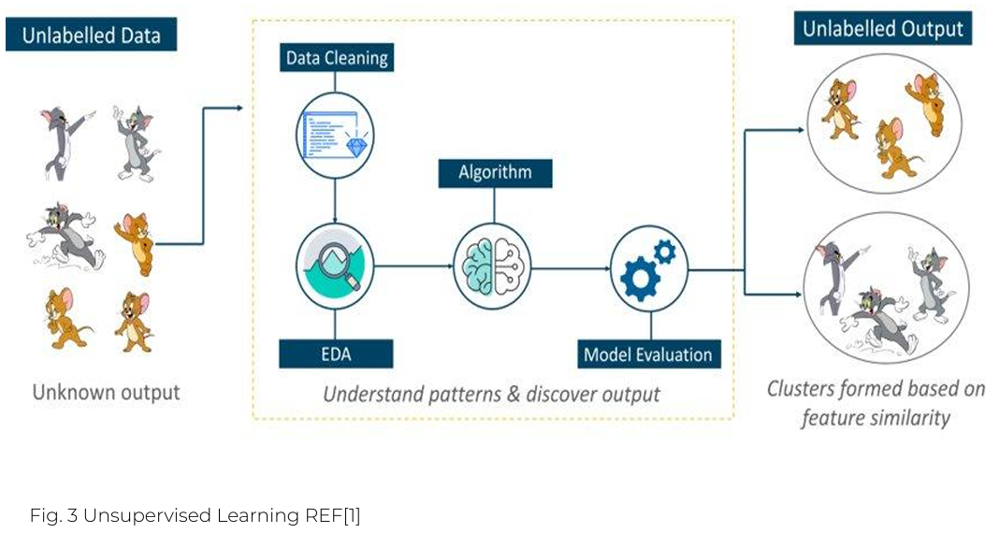
Supervised Learning
Unsupervised Learning

Slide 12
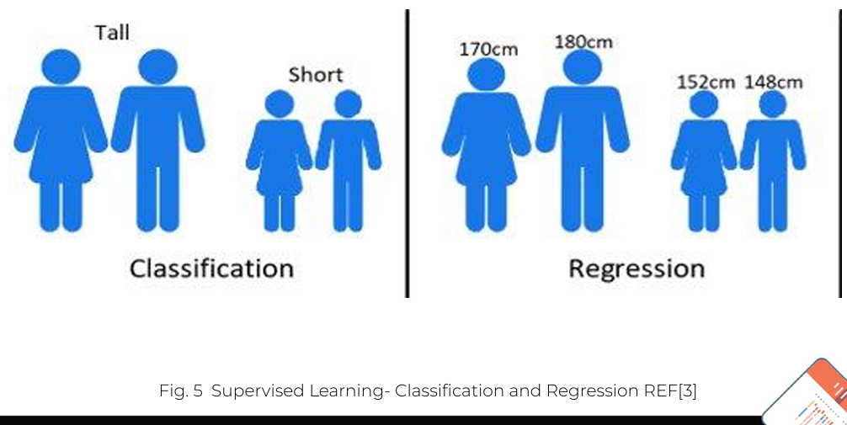
Supervised Learning
There are two categories of supervised learning:
Classification task
Regression task

Slide 13
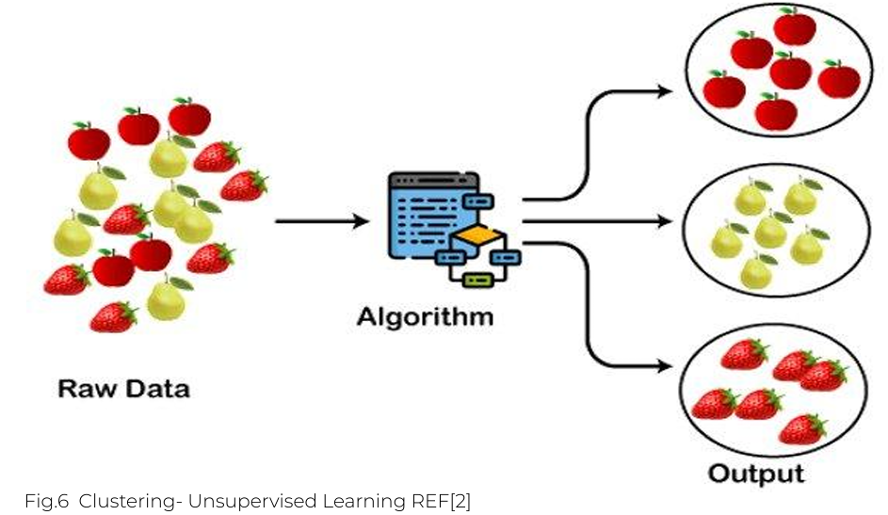
Unsupervised Learning- Clustering

Slide 14
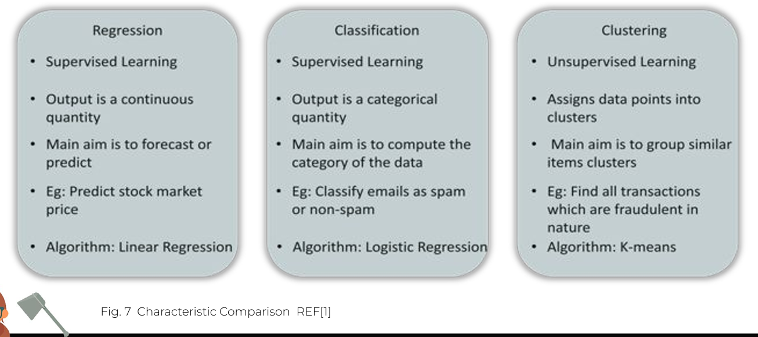
Characteristics Comparison

Slide 15
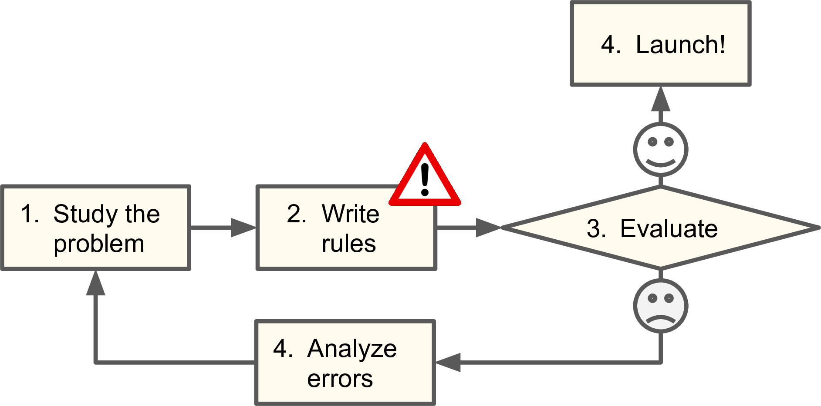
Why do we need ML? The Email Spam Problem

Slide 16
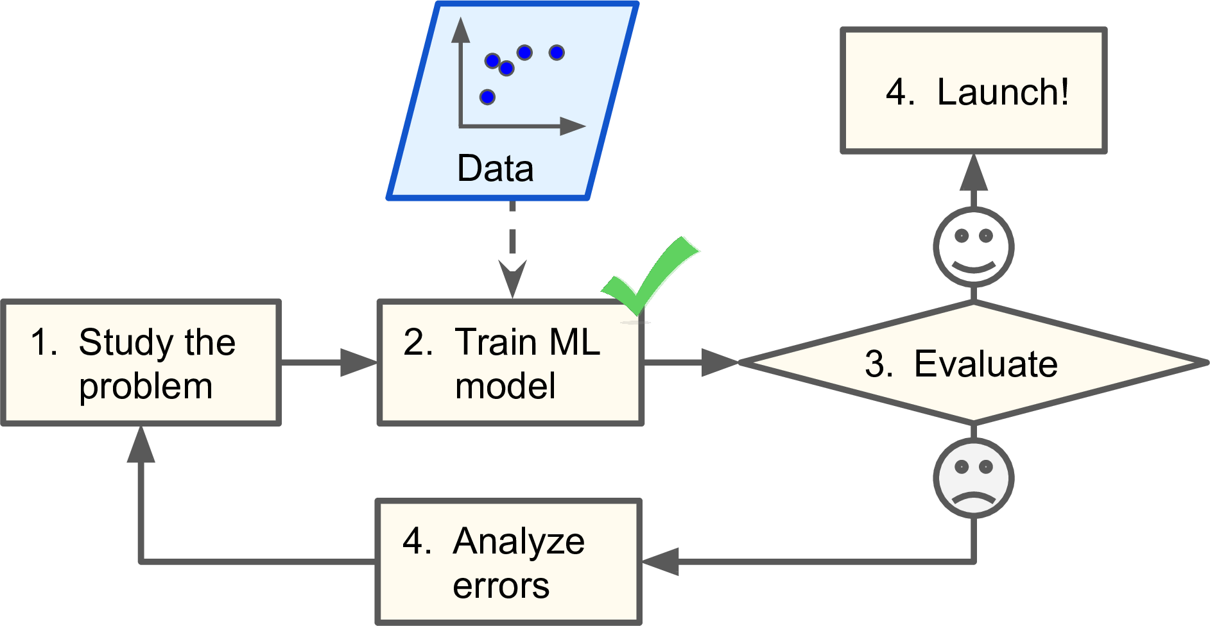
Why do we need ML? The Email Spam Problem

Slide 17
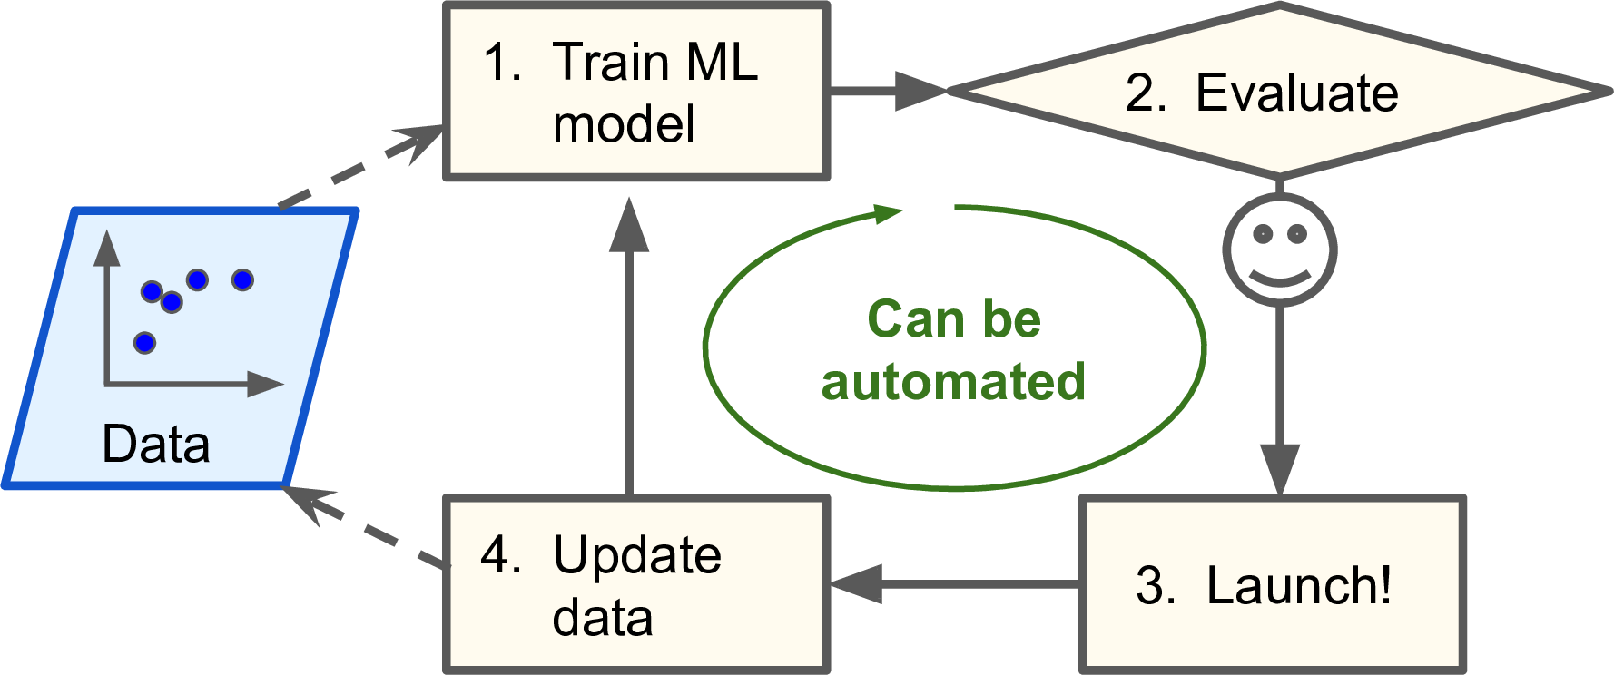

Slide 18
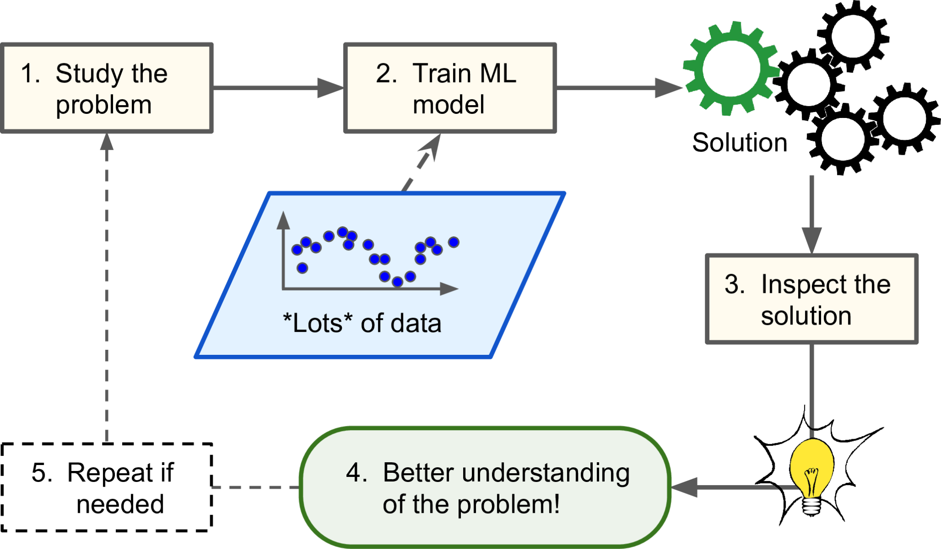
Help Humans Learn
For instance, once a spam filter has been trained on enough spam, it can easily be inspected to reveal the list of words and combinations of words that it believes are the best predictors of spam. Sometimes this will reveal unsuspected correlations or new trends, and thereby lead to a better understanding of the problem.

Slide 19
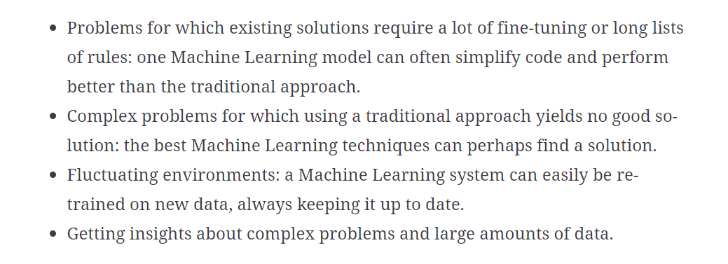
Where to use ML?

Slide 20
Some Typical Applications
Analyzing images of products on a production line to automatically classify them
Detecting tumors in brain scans
Forecasting your company’s revenue next year, based on many performance metrics
Segmenting clients based on their purchases so that you can design a different marketing strategy for each segment
Recommending a product that a client may be interested in, based on past purchases

Slide 21
Questions to be kept in mind when designing an ML System?
What question(s) am I trying to answer? Do I think the data collected can answer that question?
What is the best way to phrase my question(s) as a machine learning problem?
Have I collected enough data to represent the problem I want to solve?
What features of the data did I extract, and will these enable the right predictions?
How will I measure success in my application?
How will the machine learning solution interact with other parts of my research or business product?

Slide 22
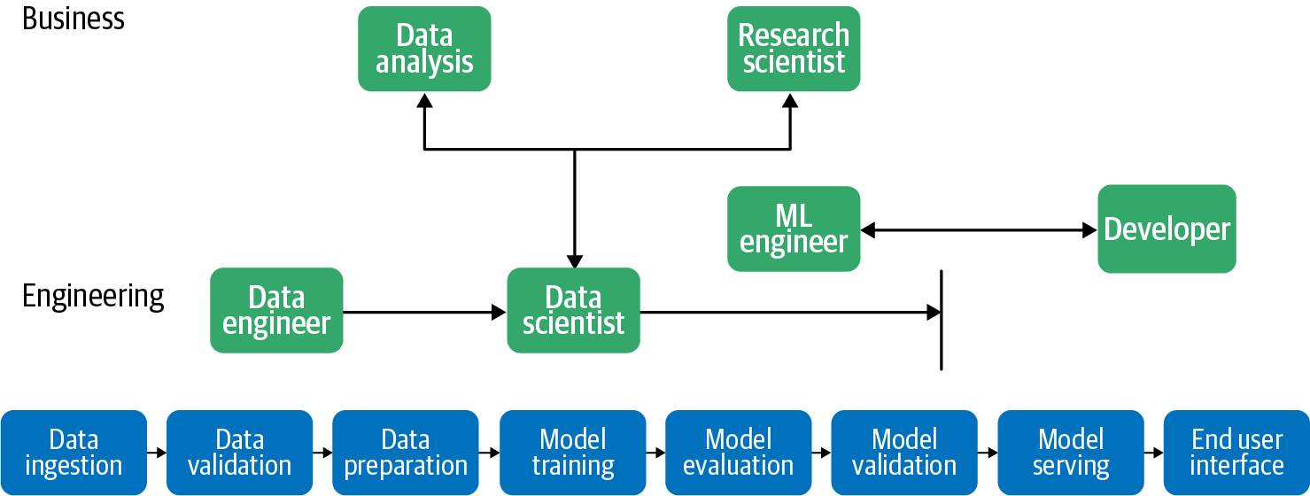
Different Roles in an Organization’s ML Model Development Process

Slide 23
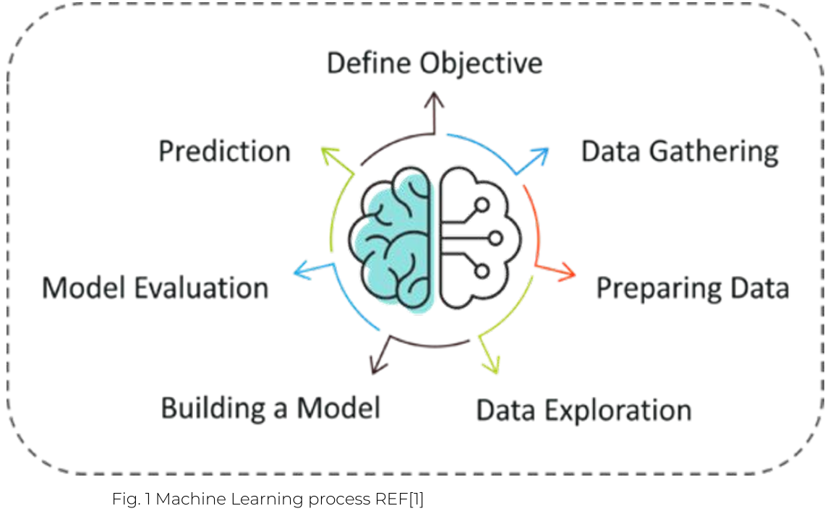
Machine Learning Process

Slide 24
Machine Learning Key Terms
Algorithm: (Logic) A Machine Learning algorithm is a set of rules and statistical techniques
Model: (Main component of Machine Learning) Algorithm maps how the decision is taken

Slide 25
Machine Learning Key Terms
Predictor Variable: It is a feature(s)/ input of the data that can be used to predict the output.
Response Variable: It is the feature or the output variable that needs to be predicted by using the predictor variable(s).
Training Data: The machine learning model is built using the training data (Learning).
Testing Data: After the model is trained, it must be tested to evaluate how accurately it can predict an outcome.

Slide 26
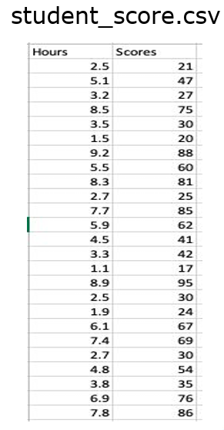
Machine Learning Key Terms
Hours- Independent Variable → X→ Predictor
Scores – Dependent Variable→ Y→ Response

Slide 27
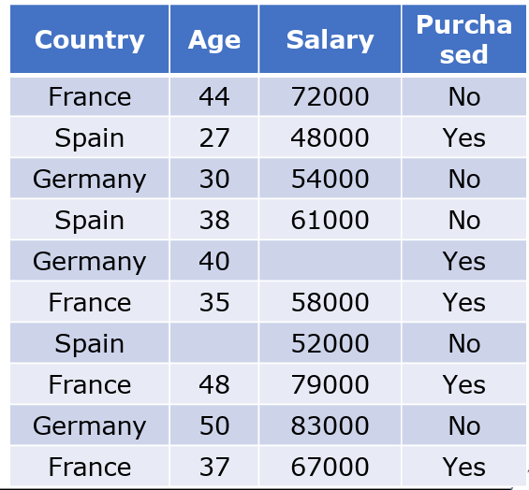
Machine Learning Key Terms
Country, Age, Salary
Independent Variable → X→ Predictor
Purchased
Dependent Variable→ Y→ Response

Slide 28
Machine Learning Key Terms
Algorithm: (Logic) A Machine Learning algorithm is a set of rules and statistical techniques
Model: (Main component of Machine Learning) Algorithm maps how the decision is taken

Slide 29
Machine Learning Key Terms
Predictor Variable: It is a feature(s)/ input of the data that can be used to predict the output.
Response Variable: It is the feature or the output variable that needs to be predicted by using the predictor variable(s).
Training Data: The machine learning model is built using the training data (Learning).
Testing Data: After the model is trained, it must be tested to evaluate how accurately it can predict an outcome.

Slide 30
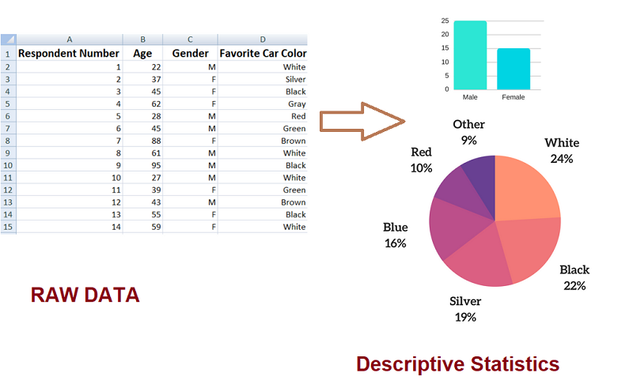
Descriptive Statistics Examples
Descriptive statistics about a class involve the average score of marks obtained by students for different courses including Maths, Physics, Chemistry.
Analyzing favorite color of CAR liked by students in a class and representing it in the form of graph or pie chart.

Slide 31
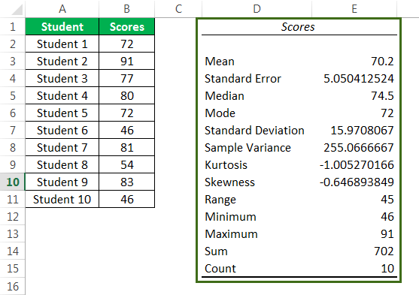
Descriptive Statistics Types
Measures of Central Tendency
Measures of Dispersion or Variation

Slide 32
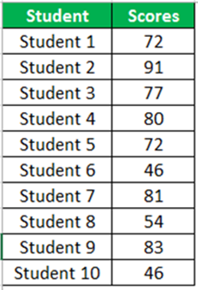
Descriptive Statistics Types
Measures of Central Tendency
Mean:
Formula 1: Sum of all values/ No. of samples= Σ (x) /N
Sum= 702, N=10, then what is Mean?

Slide 33
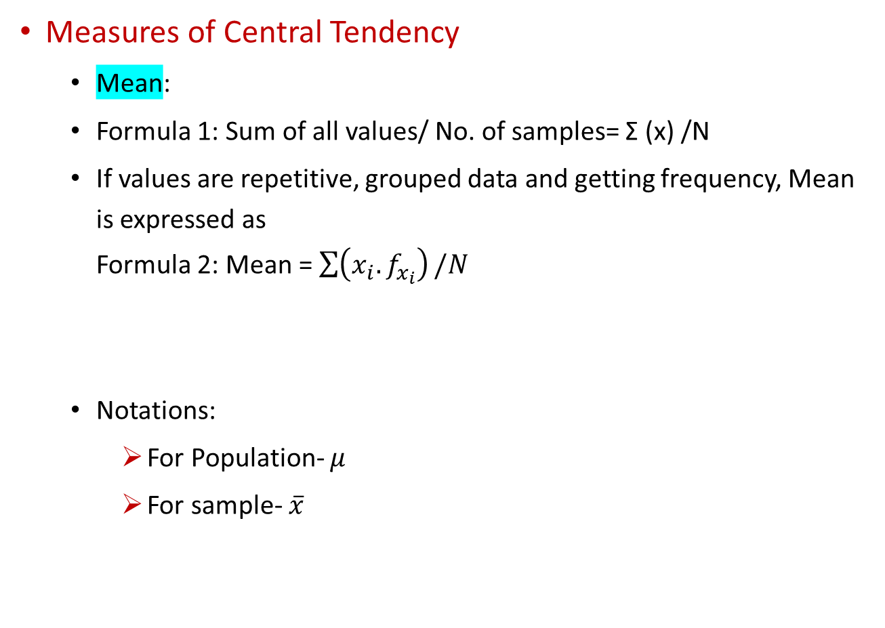
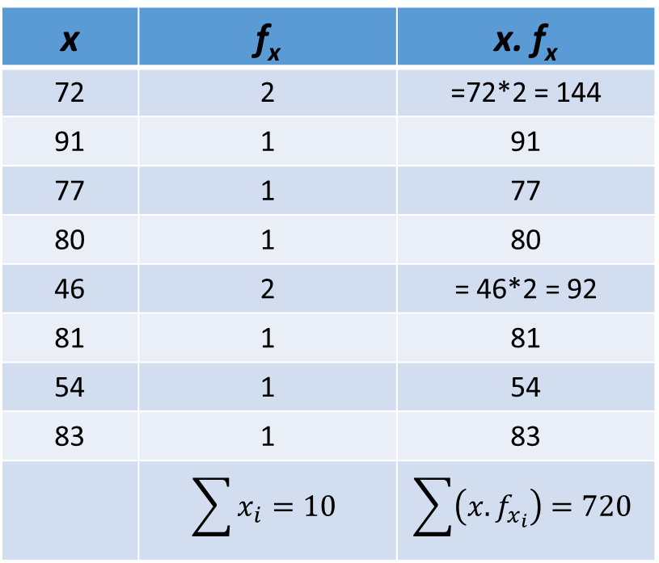
Descriptive Statistics Types
Measures of Central Tendency
Mean:
Formula 1: Sum of all values/ No. of samples= Σ (x) /N
If values are repetitive, grouped data and getting frequency, Mean is expressed as Formula 2: Mean = $\sum{\left(x_{i}. f_{x_{i}}\right)}/N$
Notations:
For Population- $μ$
For sample- $\overline{x}$
x | f_{x} | x. f_{x}
72 | 2 | =72*2 = 144
91 | 1 | 91
77 | 1 | 77
80 | 1 | 80
46 | 2 | = 46*2 = 92
81 | 1 | 81
54 | 1 | 54
83 | 1 | 83
 | $$\sum{x_{i}}=10$$ | $$\sum{\left(x. f_{x_{i}}\right)=720}$$
Population: The group we are interested in studying
Sample: A subset of Population

Slide 34
Descriptive Statistics Types
Measures of Central Tendency
Median: Middle observation
Arrange in ascending order: 46, 46, 54, 72, 72, 77, 80, 81, 83, 91
If N is even- Median is mean of [N/2 th and (N/2+1) th] elements
46, 46, 54, 72, 72, 77, 80, 81, 83, 91
If N is odd- Median is median is (N+1)/2th element
46, 46, 54, 72, 72, 77, 80, 81, 83
Measures of Central Tendency
Mode: Most repetitive value
If there is clear such unique value

Slide 35
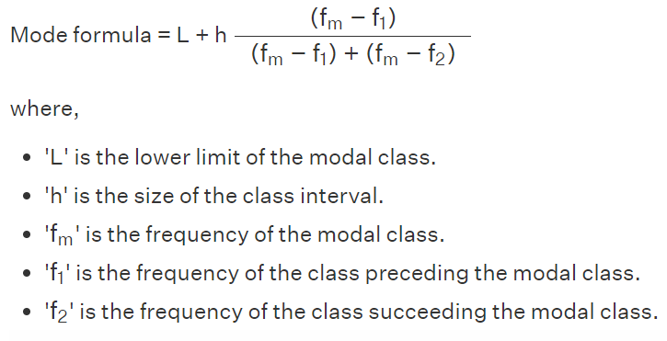
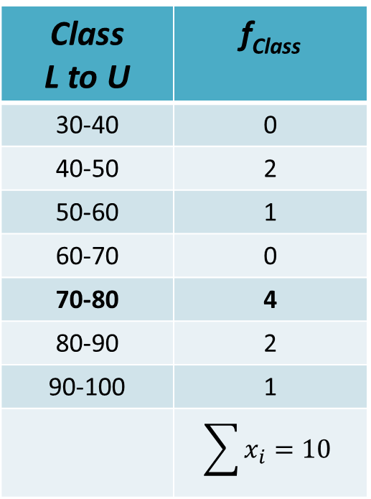
Descriptive Statistics Types
Measures of Central Tendency
Mode: Most repetitive value
If there is no such clear unique value
Class L to U | f_{Class}
30-40 | 0
40-50 | 2
50-60 | 1
60-70 | 0
70-80 | 4
80-90 | 2
90-100 | 1
 | $$\sum{x_{i}}=10$$

Slide 36
Central Tendency Question
The marks scored by students are given here:
Compute Mean, Median and mode F_{Xi}
Marks scored Xi | No. of people scoring it Freq of Xi, as F_{Xi}
1 | 10
2 | 12
3 | 20
4 | 15
5 | 10

Slide 37
Descriptive Statistics Types
Measures of Central Tendency
Measures of Dispersion or Variation

Slide 38
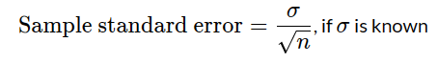
Measures of Dispersion or Variation
Dispersion in statistics describes the spread of the data values in a given dataset.
It reveals the extent to which the values of the individual items differ in a data set.
Minimum : 46
Maximum:91
Sum:702
Count:10
Range: Highest-lowest : 45

Slide 39
Measures of Dispersion or Variation
Quartiles: The quartile measures the spread of values above and below the median by dividing the distribution into four groups.
It is a measure of variability around the median.
A quartile divides data into three points—a lower quartile (Q1), median (Q2), and upper quartile (Q3)—to form four groups of the dataset.
Interquartile range: Q3-Q1
Interquartile Quartile (Q3-Q1)
1:Lowest
2:Highest
First Quartile
Q1
3:Median
Q2
Third Quartile
Q3
Find out Q1,Q2 and Q3 for given dataset
45 100 54 72 91 80 77 81 46 83 72

Slide 40
Measures of Dispersion or Variation
Find out Q1,Q2 and Q3 for given dataset
45 100 54 72 91 80 77 81 46 83 72
Steps to find Quartile:
1. Arrange data in order from lowest to highest.
2. Find Median (Q2) = (n+1)*50%= (n+1)*0.5 = (n+1)/2 = (11+1)/2= 6th
3. Find the median of the data values that fall below Q2, that gives Q1= (n+1)*25%= (n+1)*0.25= (n+1)/4 = (11+1)/4= 3rd
4. Find the median of the data values that fall above Q2, that gives Q3 = (n+1)*75%= (n+1)*0.75= (n+1)*(3/4)= (11+1)*(3/4)=9th
Interquartile Quartile
45 46 54 72 72 77 80 81 83 91 100
Lowest
Highest
First Quartile
Q1
Median
Q2
Third Quartile
Q3
Notes:
Q2 = Medain ( n+1)*0.5= (n+1)/2 or n/2
Q1= (n+1)*0.25 = (n+1)/4
Q3=(n+1)*0.75= (n+1)*3/4

Slide 41
Measures of Dispersion or Variation
Steps to find Quartile:
1. Arrange data in order from lowest to highest.
2. Find Median (Q2)
3. Find the median of the data values that fall below Q2, that gives Q1
4. Find the median of the data values that fall above Q2, that gives Q3
[ 1,2,3,4,4,5,6,8,9,10,12]
Interquartile Quartile
Lowest
Highest
First Quartile
Q1
Median
Q2
Third Quartile
Q3
Notes:
Q2 = Medain ( n+1)*0.5= (n+1)/2 or n/2
Q1= (n+1)*0.25 = (n+1)/4
Q3=(n+1)*0.75= (n+1)*3/4

Slide 42
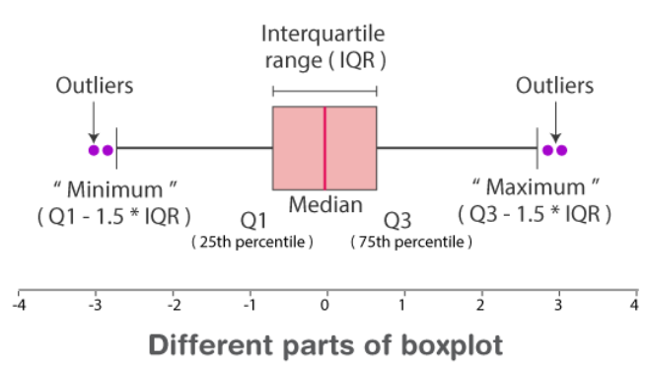
Boxplot
It is a method for graphically demonstrating the locality, spread and skewness groups of numerical data through their quartiles.
Box plot (called whiskers) indicating variability outside the upper and lower quartiles.

Slide 43
Boxplot for detecting Outliers
Minimum: The minimum value in the given dataset
First Quartile (Q1): The first quartile is the median of the lower half of the data set.
Median: The median is the middle value of the dataset, which divides the given dataset into two equal parts. The median is considered as the second quartile.
Third Quartile (Q3): The third quartile is the median of the upper half of the data.
Maximum: The maximum value in the given dataset.
Interquartile Range (IQR): The difference between the third quartile and first quartile is known as the interquartile range. (i.e.)
IQR = Q3-Q1
Outlier: The data that falls on the extreme left or right side of the ordered data is called outliers.
Generally, the outliers fall more than the specified distance from the first and third quartile.
Outliers are greater than Q3+(1.5 ×IQR) or less than Q1-(1.5× IQR).

Slide 44
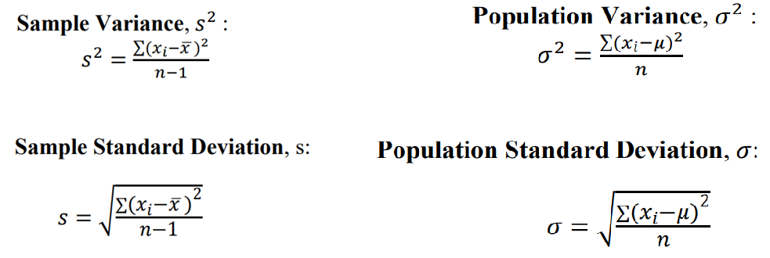
Measures of Dispersion or Variation
Measures of Dispersion with RANGE
Standard Deviation:
It provides information on how much variation from the mean exists.
However, the standard deviation shows how each value in a dataset varies from the mean.
Variance: Square of standard deviation

Slide 45
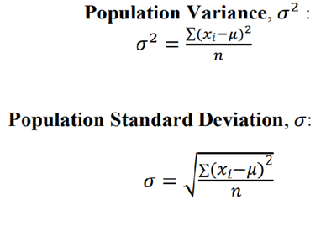
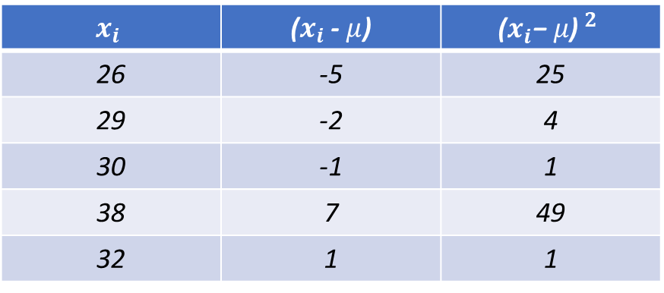
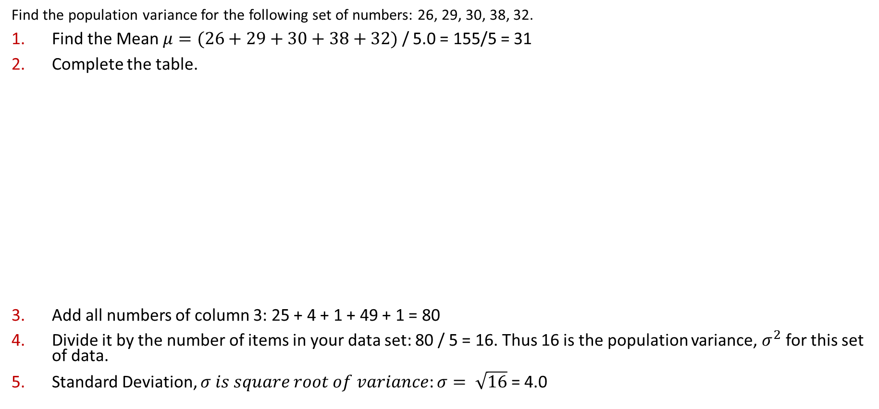
Variance and Standard Deviation
Find the population variance for the following set of numbers: 26, 29, 30, 38, 32.
Find the Mean $μ=(26+29+30+38+32)$ / 5.0 = 155/5 = 31
Complete the table.
Add all numbers of column 3: 25 + 4 + 1 + 49 + 1 = 80
Divide it by the number of items in your data set: 80 / 5 = 16. Thus 16 is the population variance, $σ^{2}$ for this set of data.
Standard Deviation, $σ$𝑖𝑠 𝑠𝑞𝑢𝑎𝑟𝑒 𝑟𝑜𝑜𝑡 𝑜𝑓 𝑣𝑎𝑟𝑖𝑎𝑛𝑐𝑒: $σ= \sqrt{16}$ = 4.0
$$x_{i}$$ | ($x_{i}$ - $μ$) | $${\text{(}x_{i}\text{−} μ\text{) }}^{2}$$
26 | -5 | 25
29 | -2 | 4
30 | -1 | 1
38 | 7 | 49
32 | 1 | 1

Slide 46
Covariance and Correlation
Covariance: Shows how the two variables differ
Correlation: Shows how the two variables are related

Slide 47
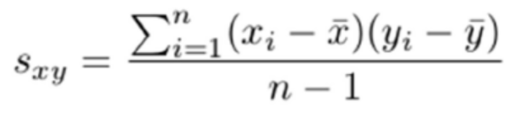
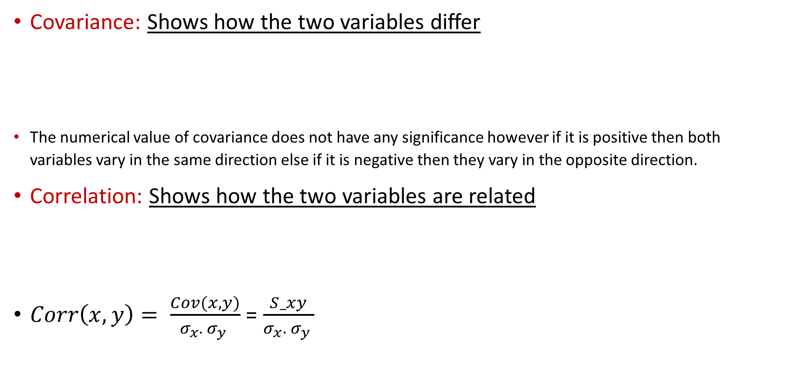
Covariance and Correlation
Covariance: Shows how the two variables differ
The numerical value of covariance does not have any significance however if it is positive then both variables vary in the same direction else if it is negative then they vary in the opposite direction.
Correlation: Shows how the two variables are related
$Corr\left(x,y\right)= \frac{Cov(x,y)}{σ_{x}. σ_{y} }$ = $\frac{S_xy}{σ_{x}. σ_{y} }$
Range: -Inf to +Inf
Covariance of x with itself is Variance of x
Range: -1 to +1
If value is -1/ + 1: Linear relationship
If value is 0: No linear relationship

Slide 48
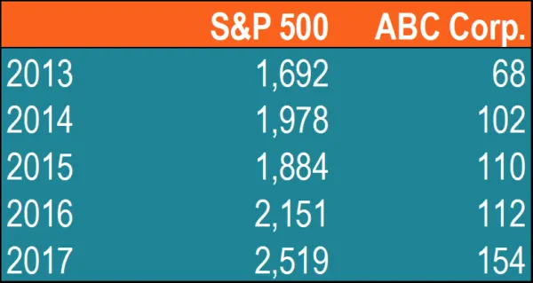
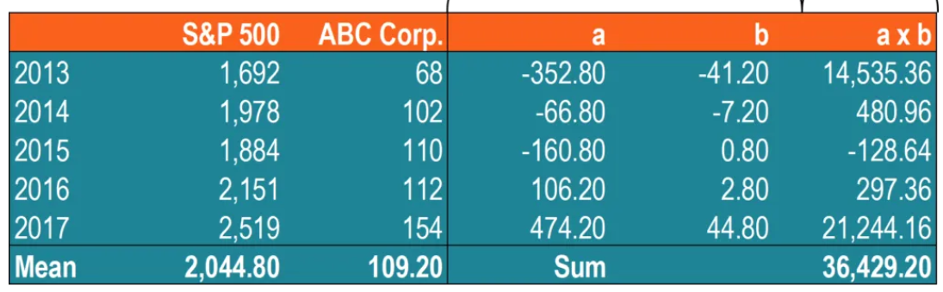
Covariance Computation
For given data, let us find Covariance.
Calculate the mean (average) prices for each asset. Mean(S&P), m1 = 2044.80, Mean(ABC Corp.) m2 = 109.20,
For each security, find the difference between each value and mean price.
Each entry in column a is entry in (column S&P 500) – m1 and
Each entry in column b is entry in (column S&P 500) – m2

Slide 49
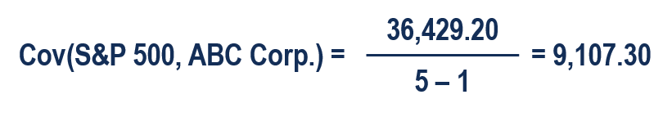
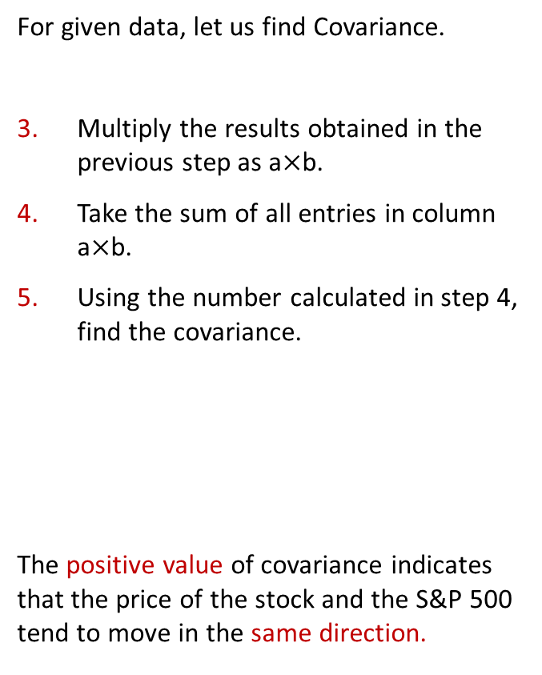
Covariance Computation
For given data, let us find Covariance.
Multiply the results obtained in the previous step as a$×$b.
Take the sum of all entries in column a$×$b.
Using the number calculated in step 4, find the covariance.
The positive value of covariance indicates that the price of the stock and the S&P 500 tend to move in the same direction.

Slide 50
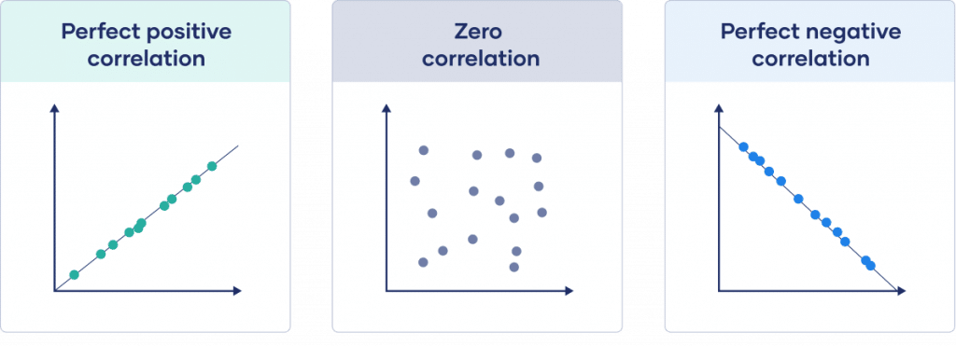
Correlation Positive/Negative
The more time a student spends watching TV, the lower their exam scores tend to be. In other words, the variable time spent watching TV and the variable exam score have a negative correlation. As time spent watching TV increases, exam scores decrease.
The more time an individual spends running, the lower their body fat tends to be. In other words, the variable running time and the variable body fat have a negative correlation. As time spent running increases, body fat decreases.
The height and weight of people have positive correlation with each other.
The correlation between the temperature and total ice cream sales is positive. In other words, when it’s hotter outside the total ice cream sales of companies tends to be higher since more people buy ice cream when it’s hot out.

Slide 51
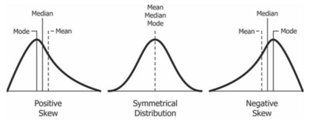
Skewness
It is a measure of the asymmetry of the probability distribution of a real-valued random variable about its mean.
The skewness value can be positive, zero, negative, or undefined.
For Unimodal Distribution:
Symmetric: Even on either side of mean (mean= median= mode)
Positive skew: tail is on the right side of the distribution (mean > median)
Negative skew: tail is on the left side of the distribution (mean < median)

Slide 52
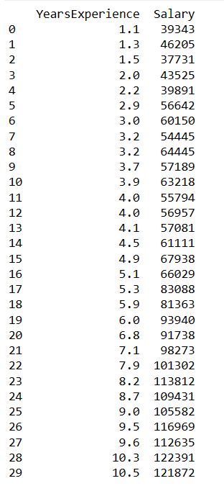
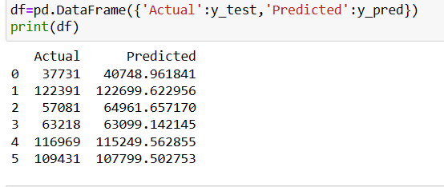
Questions:
For the following given data set (Only for Y_test), you have to calculate mean, std deviation, variance, MAE, MSE, RMSE and R2 Score.

Slide 53
Linear Regression
Linearity
Linear Regression estimates real values (cost of houses, number of calls, total sales , etc.)
Base is continuous variables.
Establish a relationship between the independent and dependent variables by fitting the best line.
This best-fit line is known as the regression line and is represented by a linear equation Y= b1X + b0.

Slide 54
Linear Regression :Example
Linear equation Y= b1X + b0.
Remember your childhood
Teacher assigns a task- Arrange all the children in the class height-wise
What you as a child would have done?
Look (visually analyze) at the height and build of people and arrange them using a combination of these visible parameters

Slide 55
Linear Regression :Example
This is a linear regression in real life!
The child has figured out that height and build would be correlated to the weight by a relationship, which looks like the equation above.
Y – Dependent Variable
a – Slope
X – Independent variable
b – Intercept (the predicted value of Y when the X is 0)

Slide 56
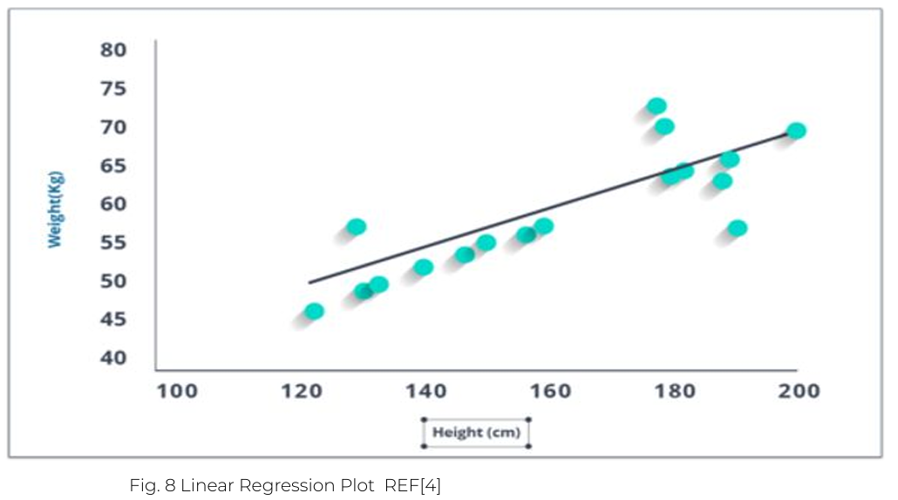
Linear Regression :Example

Slide 57
Use Case: Score Prediction
Problem Statement
Build a model to predict salary based on the number of years of experience.
Data
Use the Salary Data dataset and analyze the relationship between YearsExperience and Salary variables using a linear regression

Slide 58
Machine Learning Key Terms
Hours- Independent Variable → X→ Predictor
Scores – Dependent Variable→ Y→ Response

Slide 59
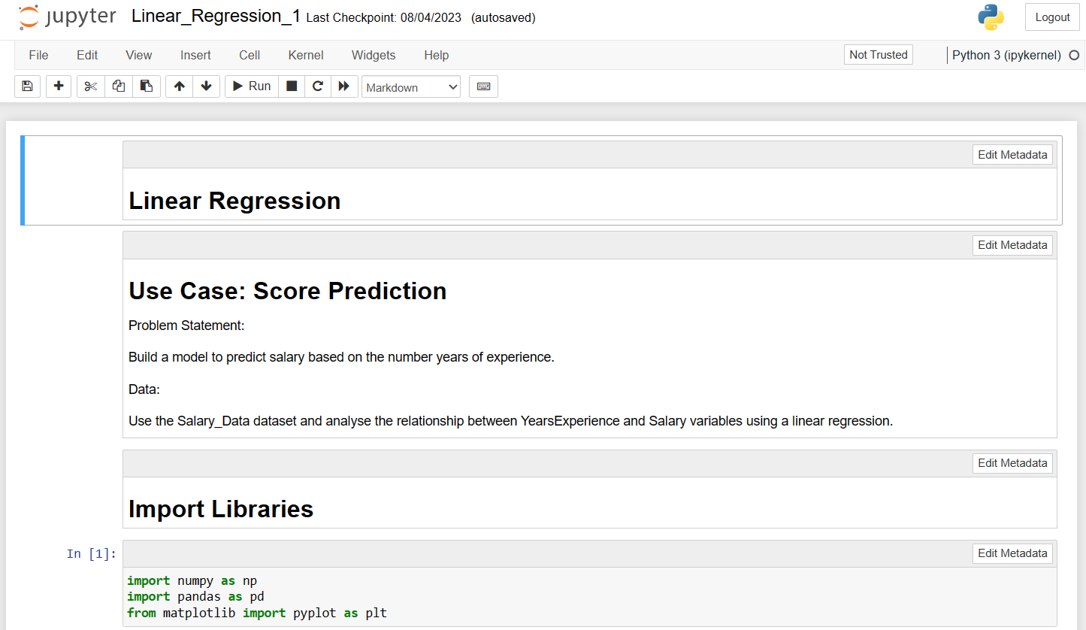
Linear Regression : Hands On

Slide 60
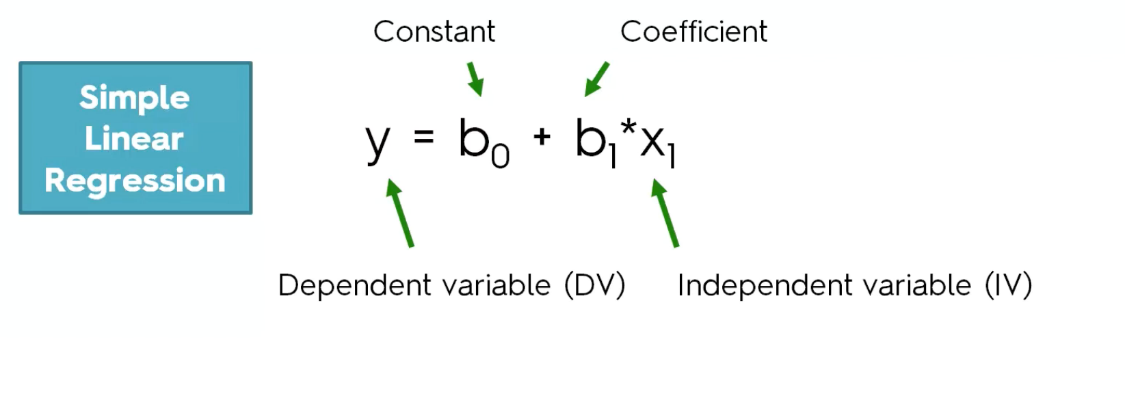

Slide 61
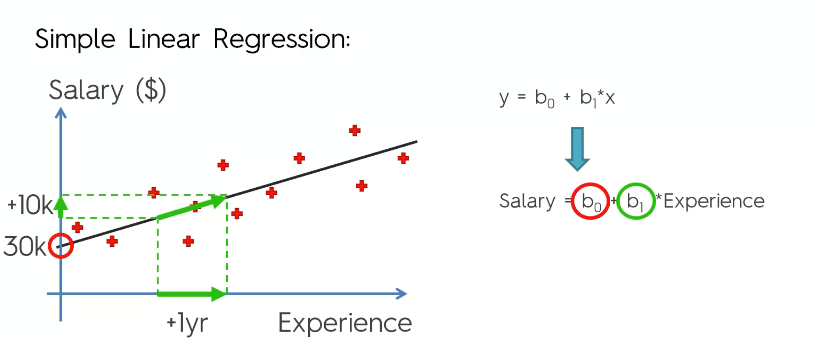

Slide 62
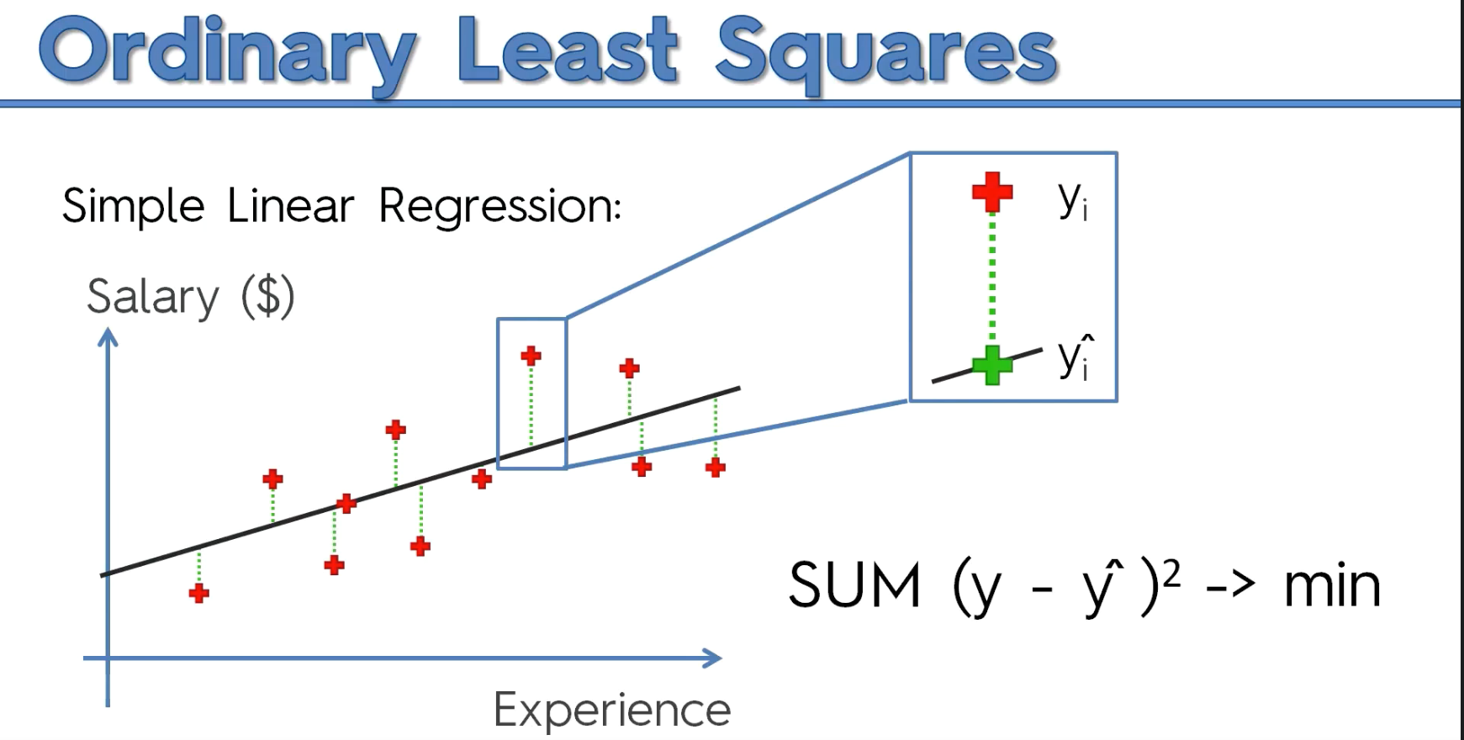

Slide 63
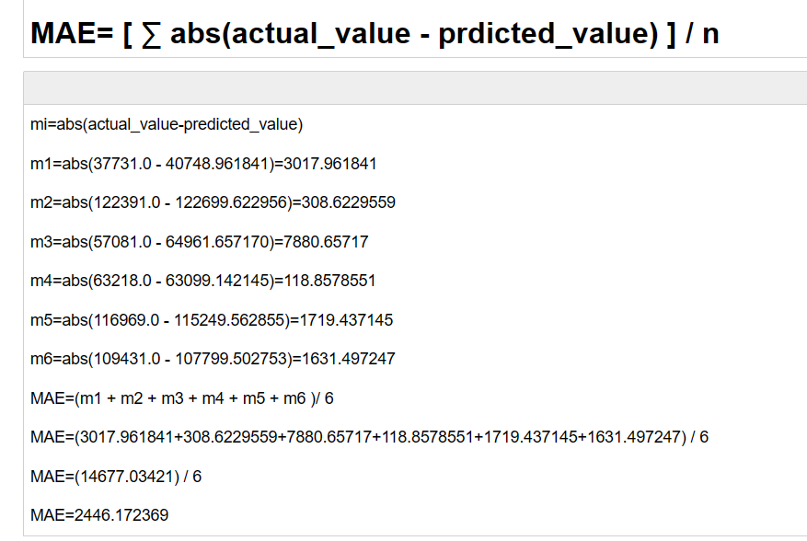
Evaluation Metrics
Mean Absolute Error (MAE)
Mean Squared Error (MSE)
Root Mean Squared Error (RMSE)

Slide 64
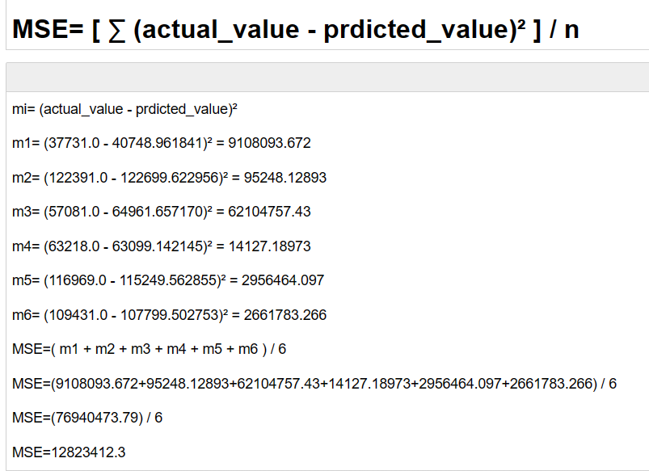
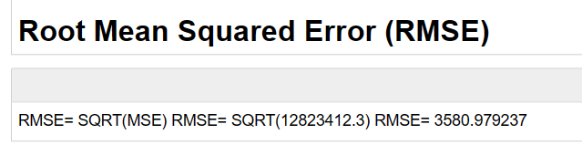

Slide 65
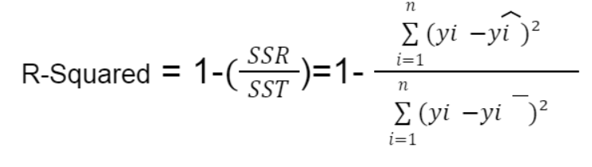


R-squared?
What is R-squared?
R squared or Coefficient of determination, or R² is a measure that provides information about the goodness of fit of the regression model. In simple terms, it is a statistical measure that tells how well the plotted regression line fits the actual data. R squared measures how much the variation is there in predicted and actual values in the regression model.
R-squared values ​​range from 0 to 1, usually expressed as a percentage from 0% to 100%.
Predicated
where:
SSR is the sum of squared residuals (i.e., the sum of squared errors)
SST is the total sum of squares (i.e., the sum of squared deviations from the mean)
Actual Mean
R squared value will be less than 0.5 or near 0.
R squared will be close to 1

Slide 66



SSR
SST

Slide 67



R-Squared = 1-(SSR/SST)
SSR
SST

Slide 68

where:
SSR is the sum of squared residuals (i.e., the sum of squared errors)
SST is the total sum of squares (i.e., the sum of squared deviations from the mean)

Slide 69
Salary Dataset write a program for simple linear regression in python

Slide 70


Slide 71

Multiple Linear Regression
Advertising_sales.csv
Independent Variables:
TV
Radio
Newspaper
Dependent Variable:
Sales

Slide 72
Multiple Linear Regression
Y= b1*X1 + b2*X2 + b3*X3 + b0
X1= TV
X2= Radio
X3= Newspaper
and
Y=Sales
Sales= b1*(TV) + b2*(Radio) + b3*(Newspaper) + b0

Slide 73
Multiple Linear Regression
Problem Statement :- Data of 50 companies. R&D Spends/Administration/Marketing Spend/State Profit (Independent Variables) (Dependent Variable)
A VC Fund is interested in investing in these companies. But has questions like :- Where companies perform better? Are these companies are those who spend more money on R&D Spend or on Marketing Spend ? Help VC Fund to build a model

Slide 74

Dummy Variable/Categorical Variable/One hot encoding

Slide 75

Dummy Variable Trap
Not Truly Independent Variables Multicollinearity = High correlation between 2 or more independent variables

Slide 76

Dummy Variable Trap

Slide 77

Multiple Linear Regression: Hands-On

Slide 78

Bias and Variance
Bias-
Prediction Error, introduced in the model
It is the difference between predicted value and actual value.
Taring Data.
Variance-
Test Data.
Error differences

Slide 79
Model Overfitting and Underfitting

Slide 80

Model Overfitting and Underfitting

Slide 81

How to avoid Underfitting in Model
Increase number of features
Increase training time of model

